Slide 1
Health Monitoring System for Docker Containers
Cloud Computing - Project Report
Barsanti Nicola
Casu Pereira de Sousa Bruno Augusto
Fregosi Frederico
Lemmi Laura
Martino Giuseppe

Slide 2
Summary
System Architecture
The Manager submodule
The Controller submodule
System Communication
Service Optimization
System Testing
Conclusions and Outlook

Slide 3

Architecture

Slide 4
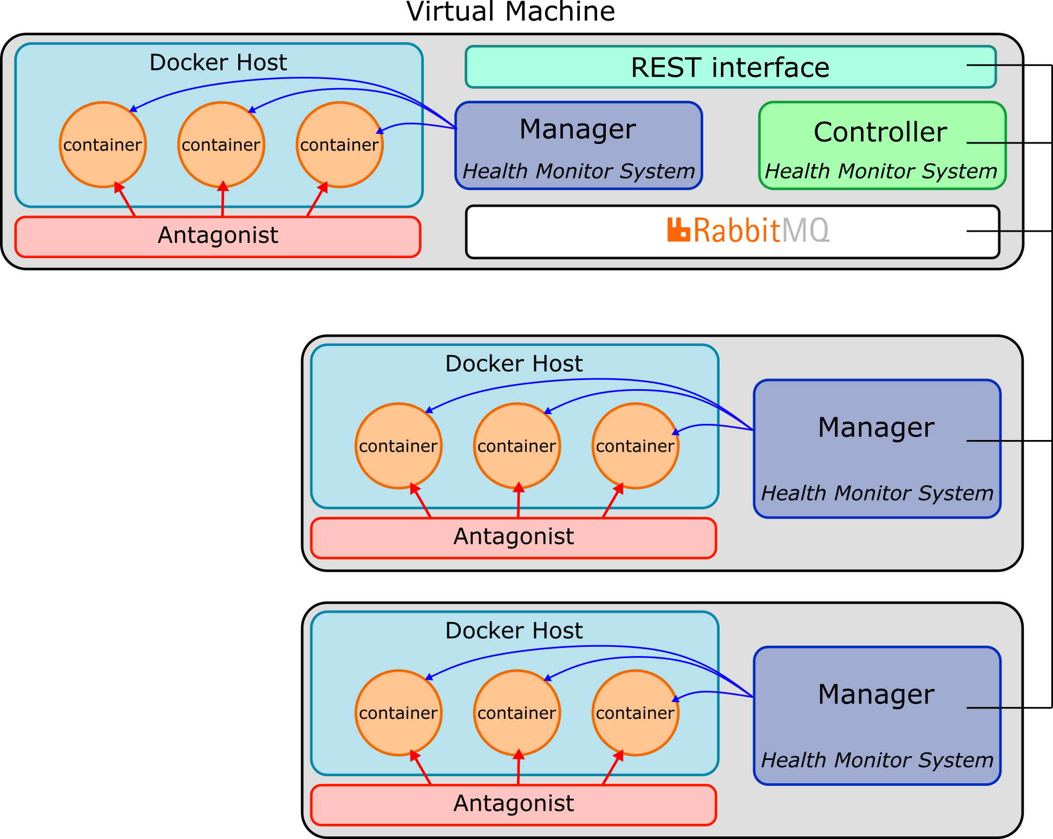
System Architecture
Health Monitoring System (HMS) architecture
Objective: Monitor the containers deployed in the VMs platform
Manager: a local submodule will check the containers status and act when a fault is detected
Controller: an overseer will manage the transmission of monitoring logs and commands in the system
Communication: the submodules exchange information a developed message queue system based in RabbitMQ

Slide 5

System Architecture
From the designed REST interface, the user will be able to verify the status of the containers and issue commands for the Managers configuration (pkt loss threshold and ignored IDs)
REST interface
User/admin
HMS Controller
Configuration
Monitoring log
HMS Manager
container
container
Docker Host

Slide 6
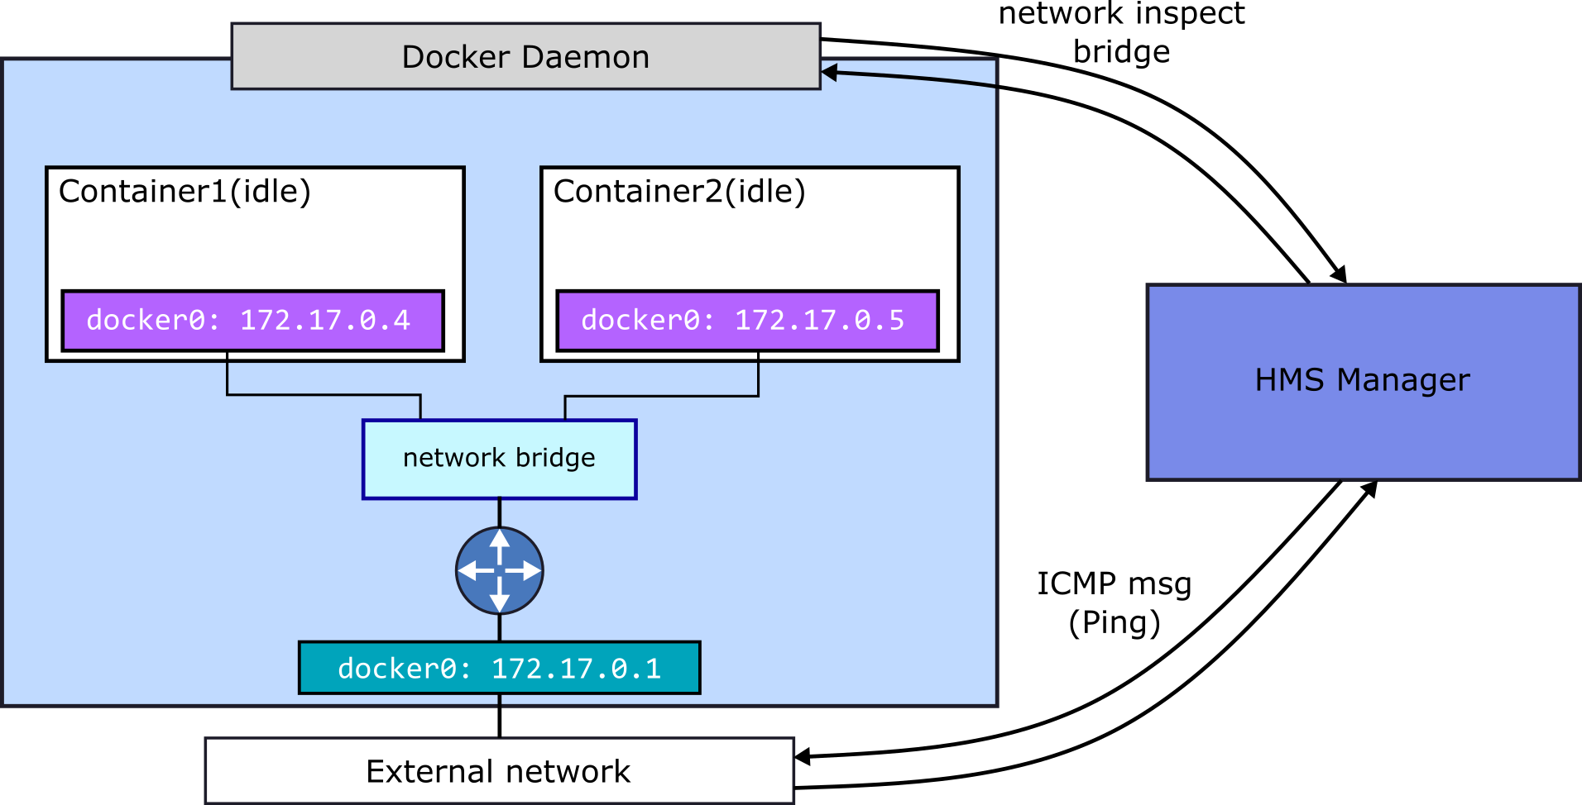
The Manager submodule
Each Manager deployed in the platform will interact with the local Docker Host daemon, retrieving a list of running containers and their status
The Manager will also interact with the docker network bridge, and will periodically send ICMP messages (Ping) to the listed containers, checking for the packet loss

Slide 7
The Manager submodule
Manager monitoring Algorithm
Get containers list
After the monitoring process, the Manager sends and update to the Controller if any container was restarted
Check if ID is in ignored List
True
False
Go to next ID
Check status
“exited”
“running”
Is container restarting?
Ping
Threshold
exceeded
False
Container OK
Restart container
Save monitoring log
Go to next ID

Slide 8
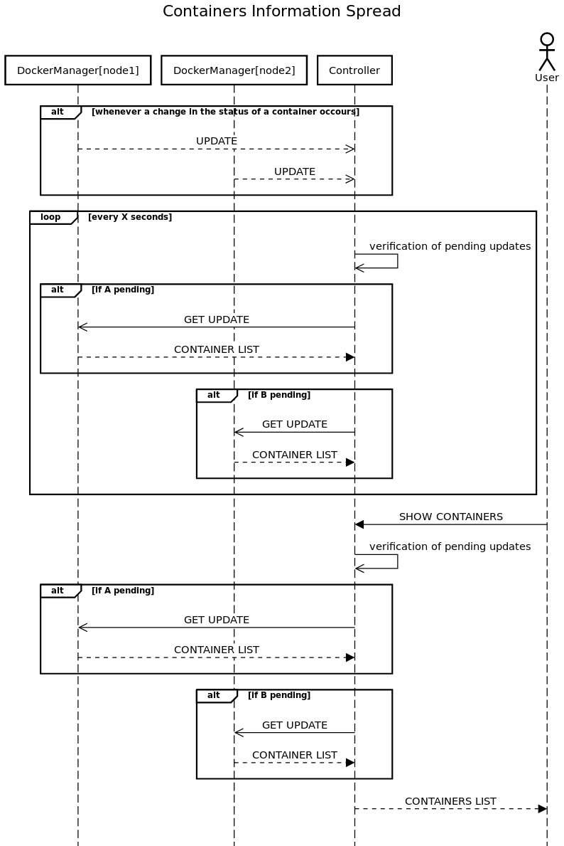
The Controller submodule
For the overall supervision of the platform, the Controller submodule was developed to manage the information exchange in the HMS
Updates will be sent by the Managers
The Controller tracks the Managers with pending updates
After a defined period, the Controller requests the monitoring log
The Controller updates the REST interface
with the container list and info

Slide 9
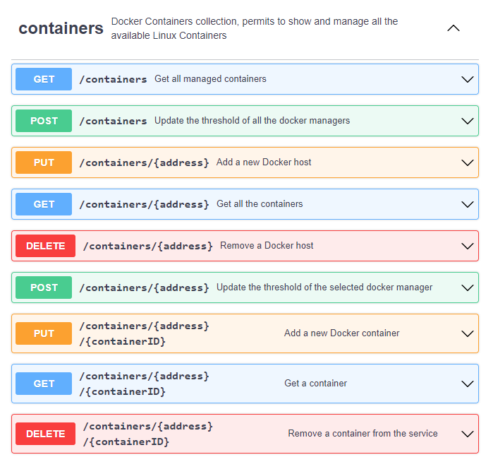
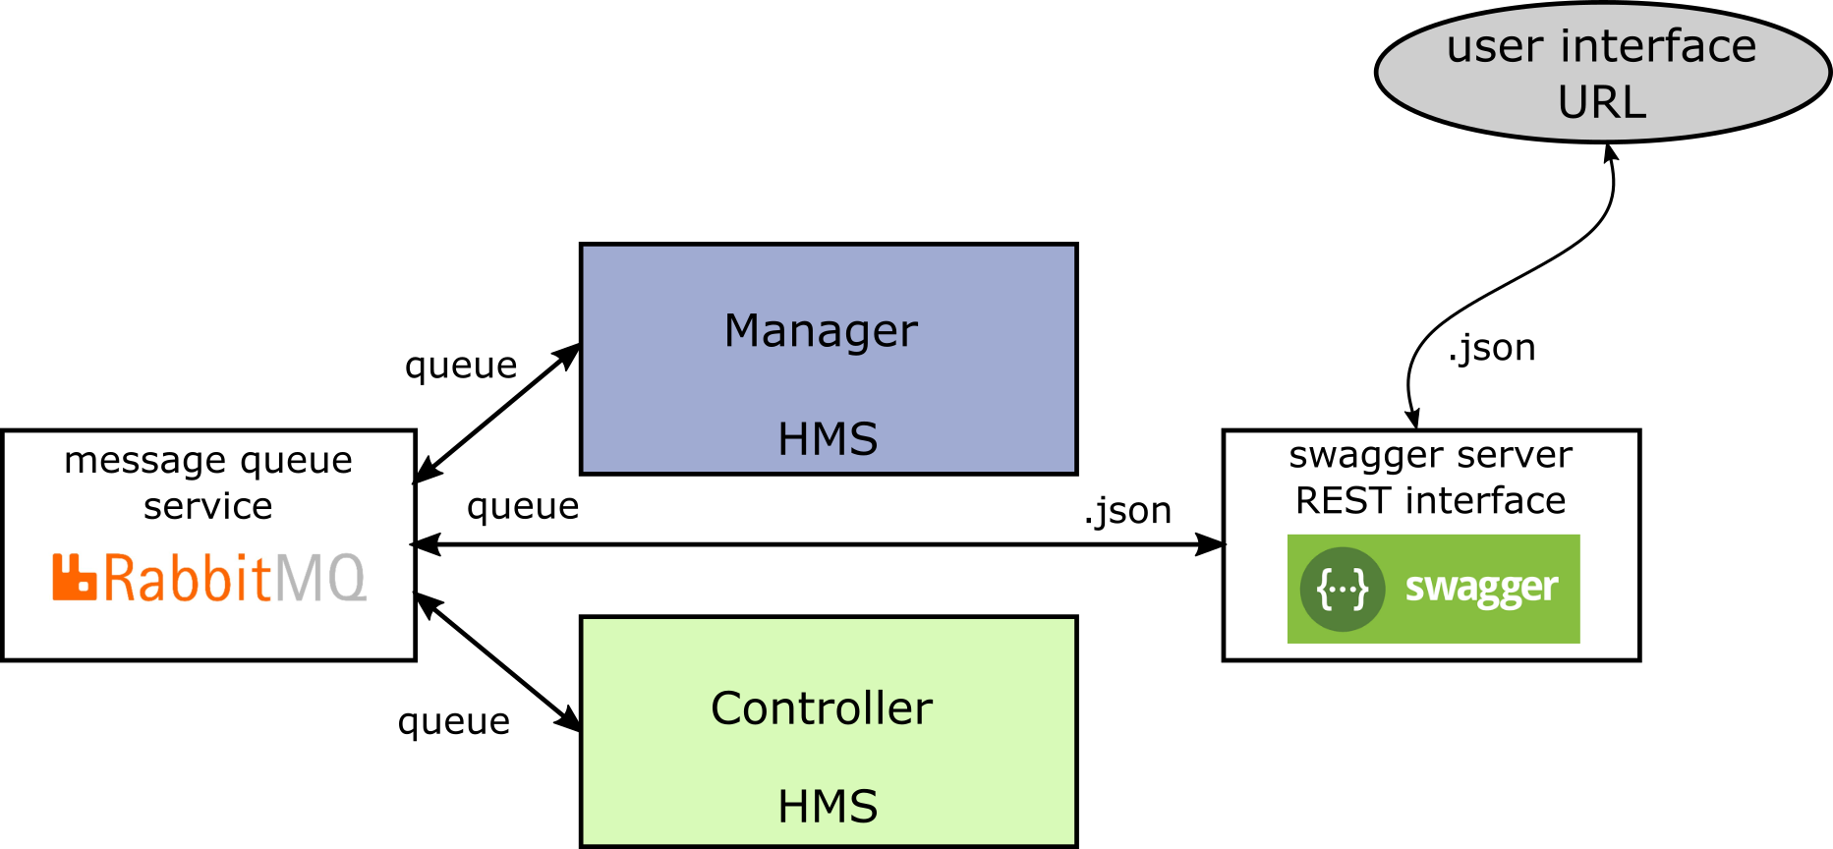
The Interface submodule
Health Monitoring System (HMS) user interface
From the developed REST interface, the user can obtain the list of running container and their status
Also, from, the available commands, the user may set the parameters for the system monitoring, such as the packet loss threshold and the ignored containers
All this information is passed through the Controller and is transmitted using the message queue system

Slide 10

Communications

Slide 11
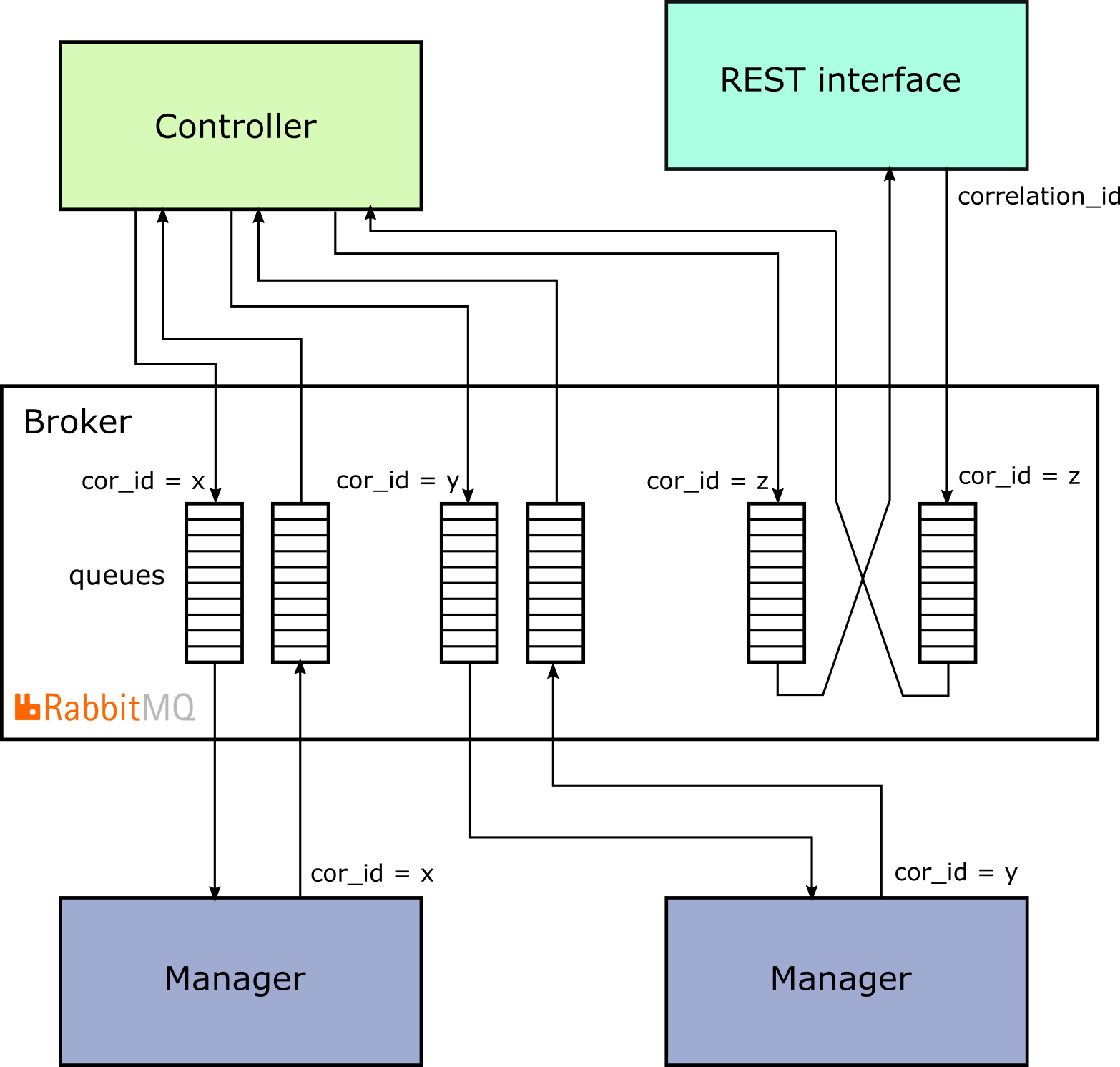
Communications Overall
For the communication we have used a RabbitMQ message broker
Each RabbitMQ client consists of two different queues, one to receive the requests from the other modules and the other the receive replies to the module requests
Communication between the module can be asynchronous or synchronous

Slide 12
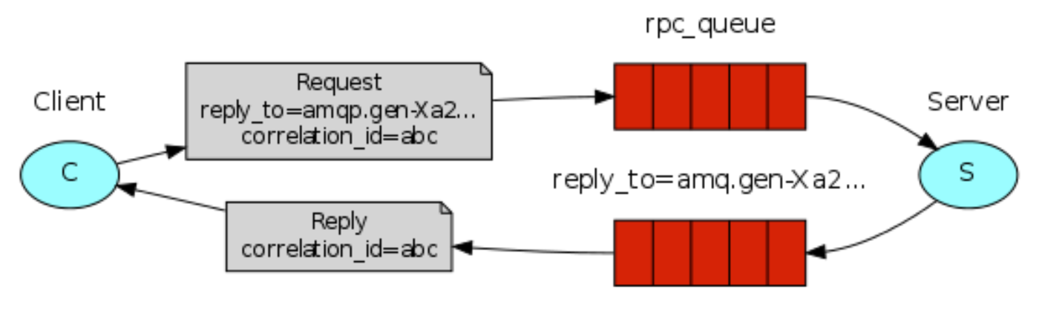
Synchronized Messaging
To implement the synchronous communications we have used a mechanism based on a callback channel
The callback channel is used to receive the reply to a request
Each request and reply have a correlation id associated which is used from the client to identify the origin request and forward the response to the correct thread

Slide 13

Optimizations

Slide 14
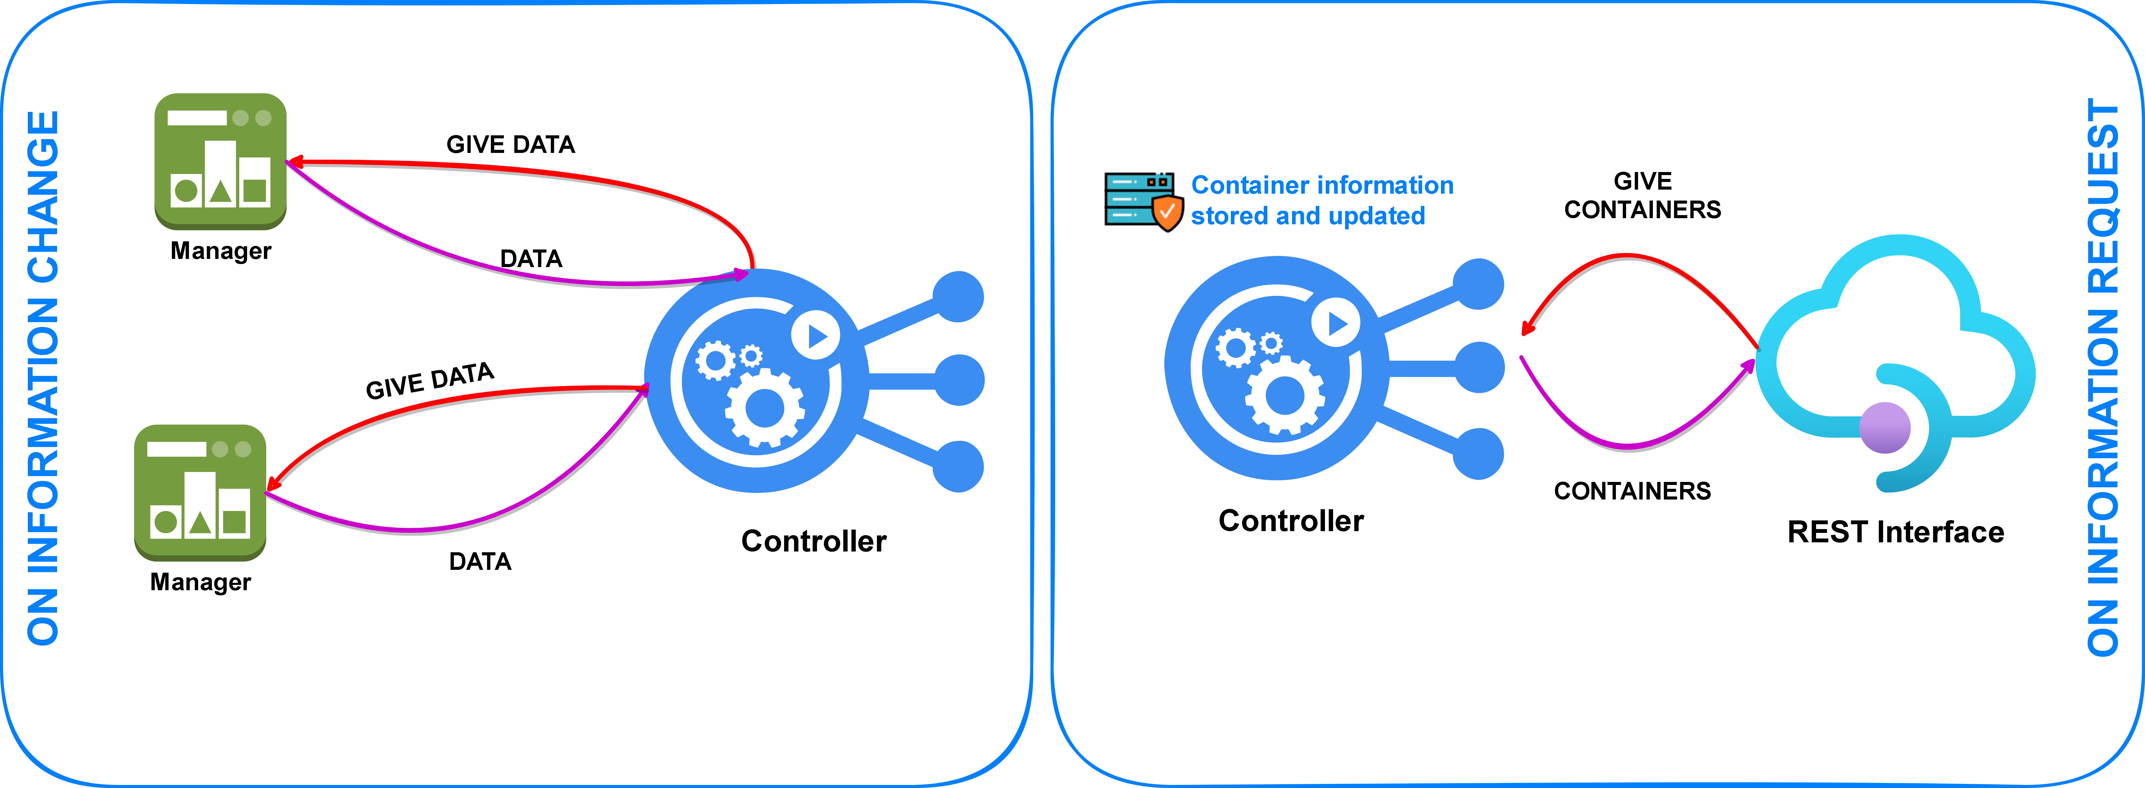
Asynchronous Information Update
To increase system performance it is important to avoid involving as many components as possible
For the containers information we have introduced a caching mechanism, in this way the controller can respond directly to a request without get the data from all the managers
The controller is responsible for keeping an up-to-date copy of all container information

Slide 15
Update Management
For testing purpose we have decided to implement an aggregation mechanism for the updates management
Updates will be sent by the Managers
The Controller tracks the Managers with pending updates
After a defined period, the Controller requests the monitoring log
The Controller updates the REST interface
with the container list and info

Slide 16

Testing

Slide 17
Antagonist
The antagonist module is designed to attack the containers using two possible metodologies:
Shutdown a container
Introduce a packet loss on the container
Five different configuration parameters available:
Heavy: defines the probability of performing an attack
Balance: defines the balance between the shutdown and the packet loss attack
Duration: defines the mean duration of the packet loss attack
Frequency: defines the mean waiting time between two attack trials

Slide 18
Testing phase
With the mechanism introduced before we can generate a more or less reactive service basing on the aggregation time
However we expect that the more reactive the system is the more the bandwidth will be consumed by the service
With the testing phase we wanna find the best aggregation time in order to keep the service available(the controller is updated with the maanger status more frequenty and the user doesn’t have to wait for additional requests to the managers) but at the same time maintaining the bandwidth contained
Heavy | Loss | Duration | Balance | Frequency
25 | 80 | 5 | 70 | 1
25 | 80 | 5 | 70 | 0.1
90 | 80 | 20 | 70 | 1
90 | 80 | 20 | 70 | 0.1
Tested aggregation times: 0.1s, 1s, 2.5s
Greaters aggregation times makes the test predictable

Slide 19
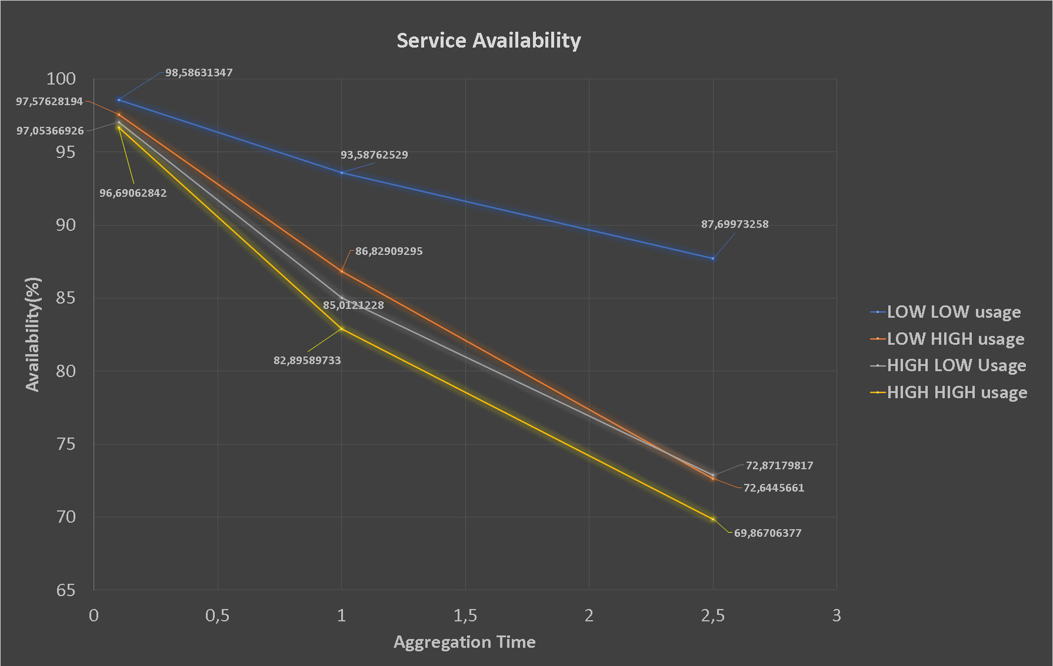
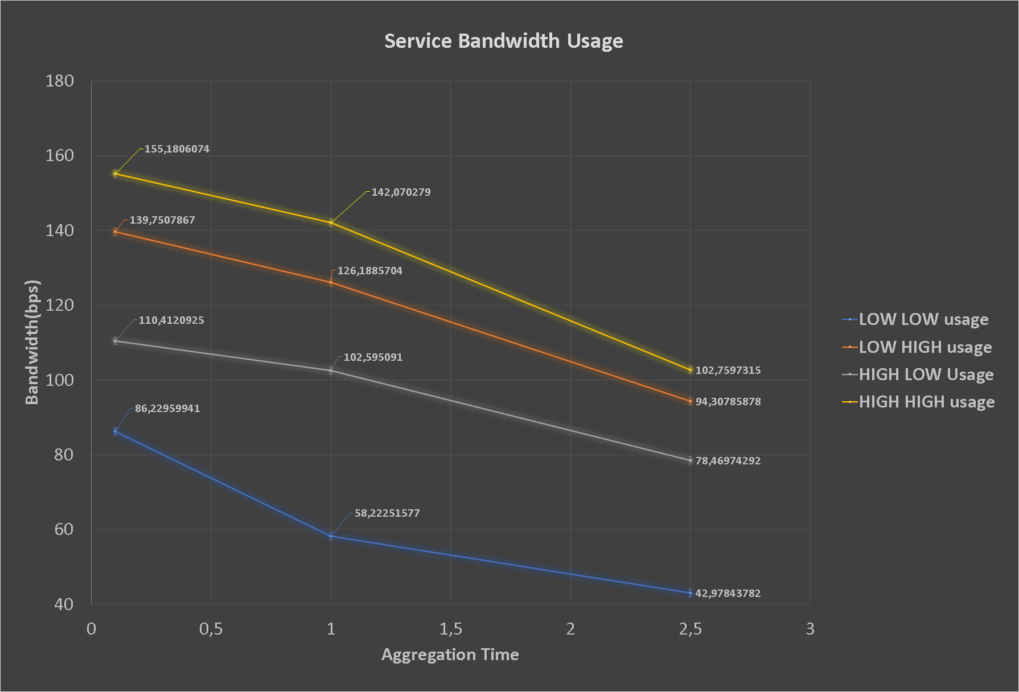
Results
How expected during attacks the aggregation time have a big impact on the availability of the system
With aggregation times greater than 1s the system became poorly available
How expected the aggregation time have an impact on the bandwidth used by the service
We have an increasing of the bandwidth used that is ……. With the decreasing of the aggregation time

Slide 20
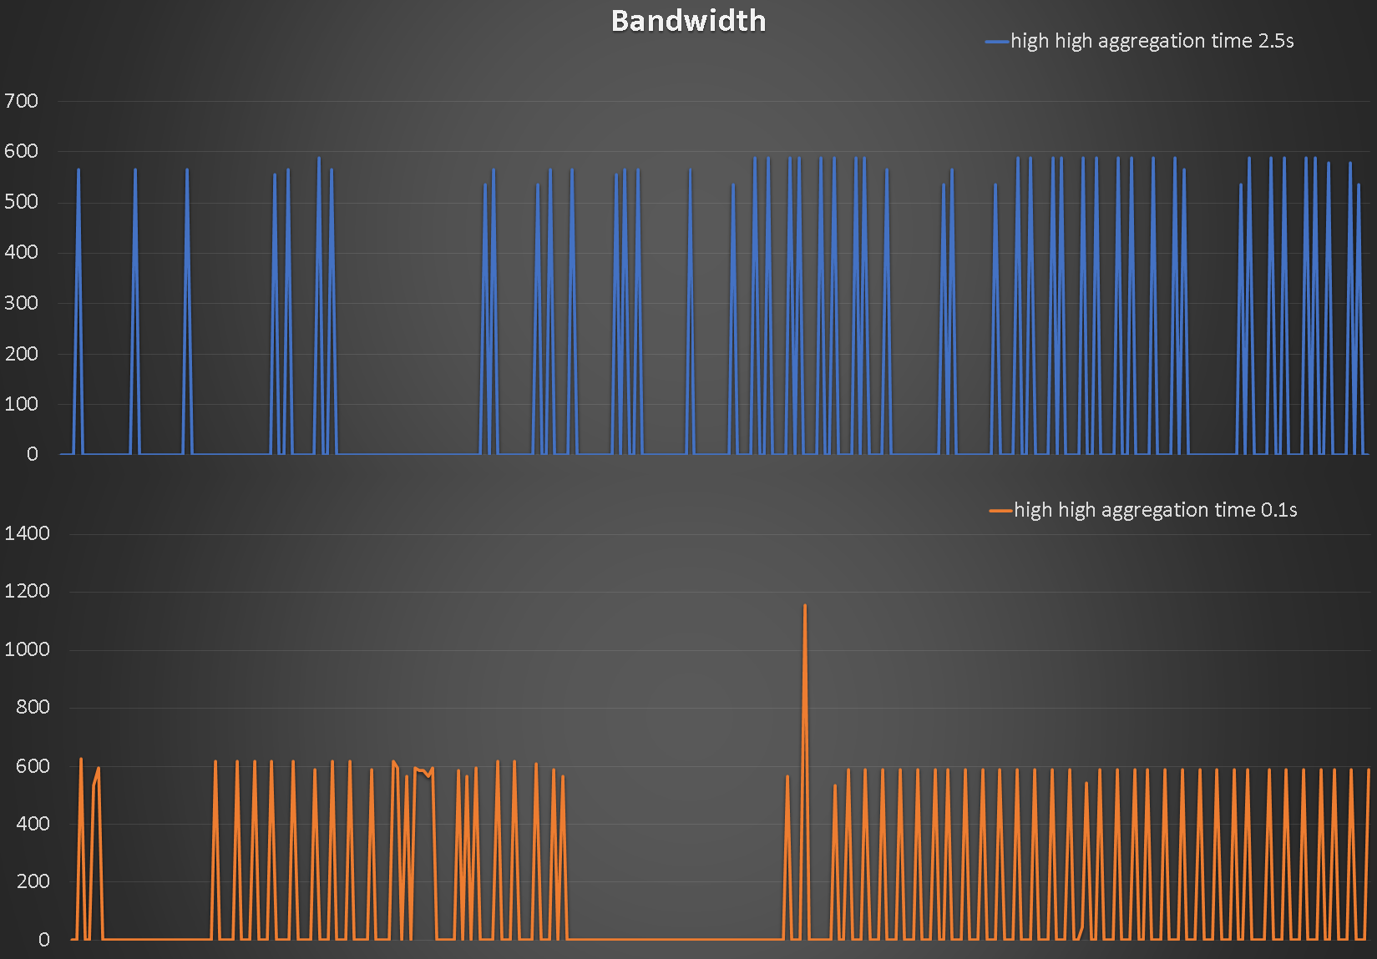
Peak Generation
A particular trend which we have considered important is the behaviour of the bandwidth. This because we have to consider:
The bandwidth is measured with an aggregation of the mean byte per seconds during the time. This method hides what happens inside the system
For the most of the time the bandwidth is equal to zero
Greater aggregation times leans to greater peaks into the bandwidth usage due to more data to be exchanged into an update
However our assumptions was incorrect. How we can see from the graph, the less is the aggregation time the more is the peak generation. This is due to the high increasing of the update exchanges

Slide 21
Conclusions
After the testing of the overall system the results has showed that to be optimized we need to keep the aggregation time less than 1s. However if it is deployed into big environment generating high loads into the communications and it is acceptable to have some delay on the responses we suggest to increase the bandwidth or maybe produce some dynamic mechanism to decrease the aggregation time in case of attack
Future Improvements
The system produced is able to manage in a scalable manner a set of docker hosts. However there are a set of improvements that can be added in future releases to the service:
More parallel controllers/rest interfaces can be added and integrated quickly into the service to gain more robustness
Implementing an anycast communication between the rest interface and the controllers can highly increase the availability of the service
Implementing a more efficient multicast communication between the controller and the managers can produce an more performant service

Slide 22


